Slide 1
Military Drones
David Cisneros
Jacob Jovel
Oscar Gonzales
Byron Franco

Slide 2
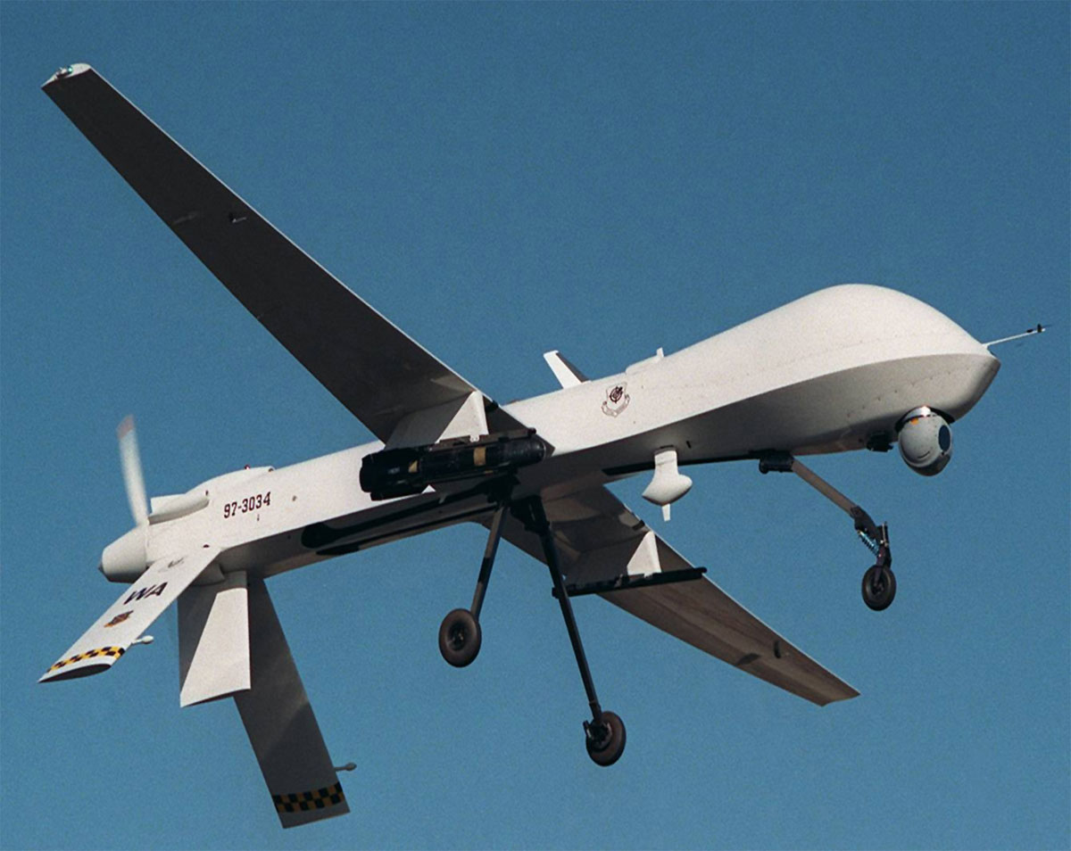
What are Military Drones?
UAV

Slide 3
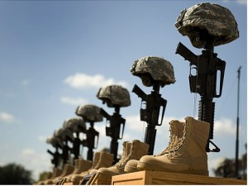
Pros
Lowers risk of losing troops

Slide 4
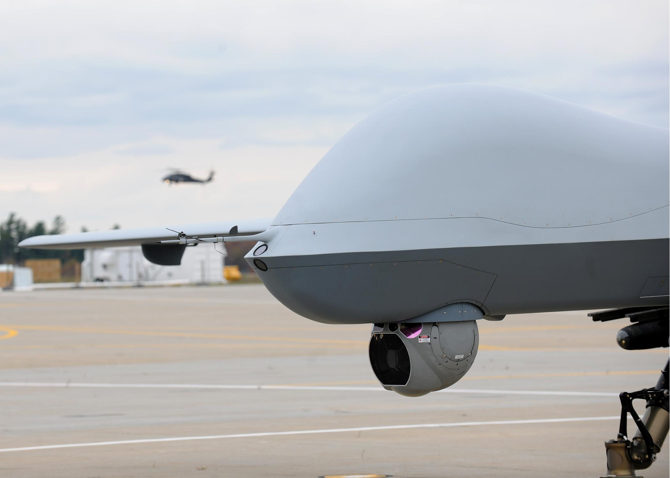
Pro
24 hour Surveillance

Slide 5
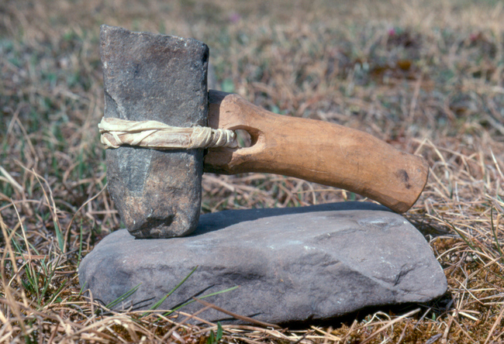
Pro
Hard to destroy

Slide 6
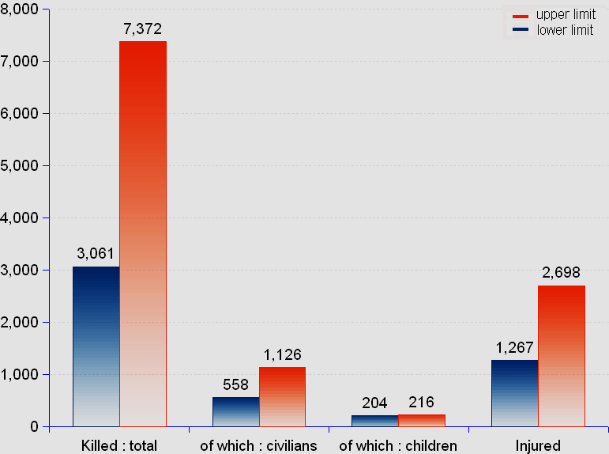
Con
Kill and Injure many citizens

Slide 7
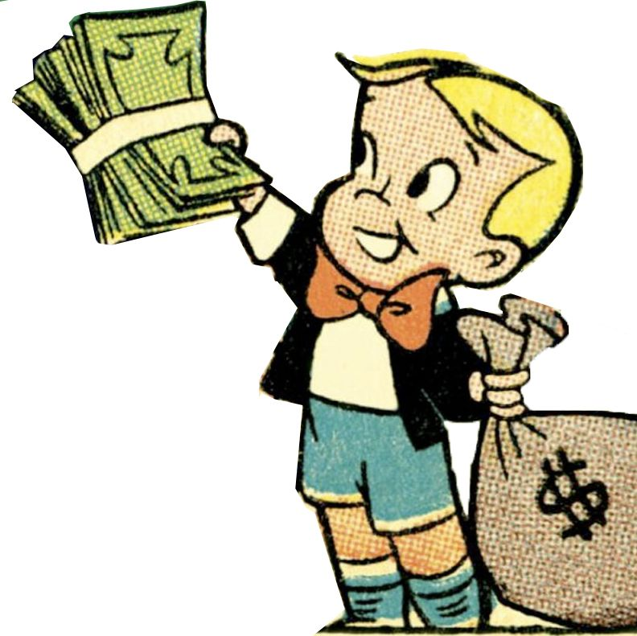
Con
very expensive

Slide 8
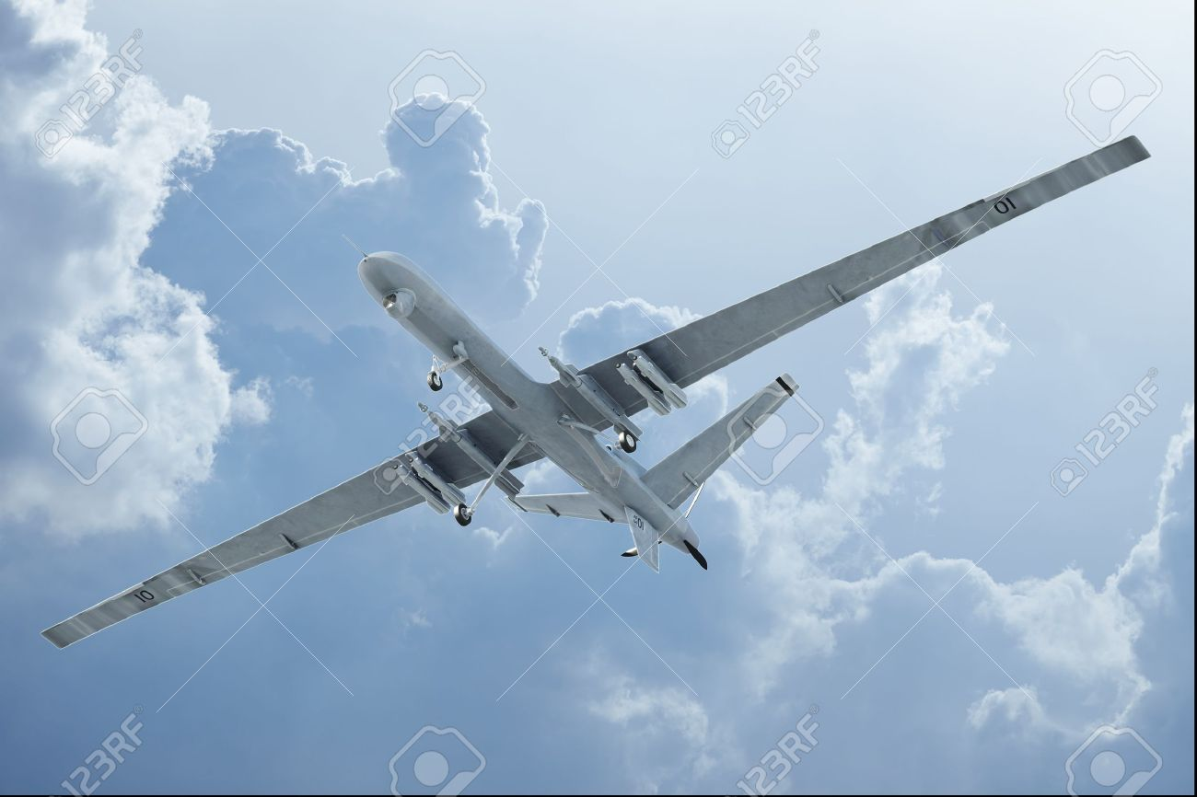
Con
too high in the sky

Slide 9
Ethical Dilemma
creating more terrorists than they kill

Slide 10
MLA Works Cited
S
<"U.S. Increasing the Pressure on Al-Shabaab - CNNPolitics.com." CNN. Cable News Network, n.d. Web. 01 Oct. 2015.>.
"Drones - ProCon.org." ProCon.org. N.p., n.d. Web. <Drones - ProCon.org>.
""Pros and Cons." Google Books." "Pros and Cons." Google Books. N.p., N.d. Web. 01 Oct. 2015. N.p., n.d.

Slide 11
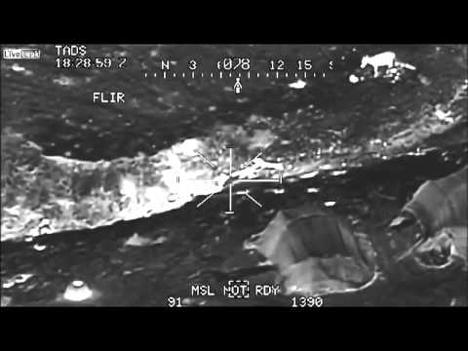
http://youtu.be/empE_7P1Q6c
youtubeinmp4.com

